Slide 1

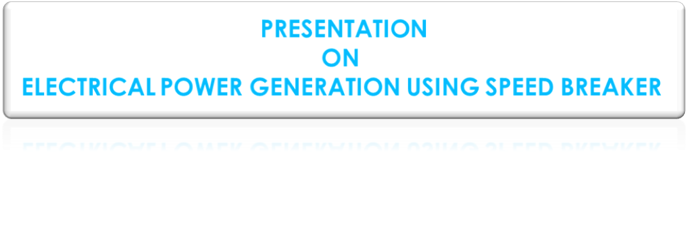
RASHTRAKAVI RAMDHARI SINGH DINKAR COLLEGE OF ENGINEERING BEGUSARAI
Under the guidance of Asst. Prof. MR. RAHUL KUMAR
Presented By: -
Sonu Kumar Paswan (19102125003)
Ramnarayan Mandal (19102125013)
Bhushan Kumar (19102125014)
Avinav Raj (19102125016)
Shankar Kumar Yadav (19102125053)

Slide 2
CONTENTS
ABSTRACT
INTRODUCTION
LITERATURE REVIEW
OBJECTIVE
EQUIPMENT REQUIRED
KEYWORK
METHODOLOGY
FUTURE SCOPE
CONCLUSION

Slide 3
ABSTRACT
Using speed bump for power generation by using gear arrangement and electronics gadgets. Large amounts of electricity can be generated saving lot of money. And if we implemented will be very beneficial for us. When vehicle is in motion it produces various forms of energy like, due to friction between vehicle’s wheel and road i.e. rough surface HEAT Energy is produced. The principle involved is POTENTIAL ENERGY TO ELECTRICAL ENERGY CONVERSION.
The system generates power by converting the potential energy generated when a vehicle travels over a speed bump into kinetic energy. As the vehicle moves over the inclined plates, it gains height, leading to an increase in potential energy that is typically wasted in a traditional rumble strip. However, in this system, when the vehicle descends from the speed bump, it activates a lever attached to a ratchet-wheel mechanism, facilitating angular motion conversion. This mechanism, in turn, rotates a geared shaft that is equipped with recoil springs. The output from this shaft is then connected to a dynamo, which converts the kinetic energy into electricity. This constitutes the concise process for generating electrical power through a speed bump.

Slide 4
Introduction
Electricity secondary source of energy i.e. converted from other sources.
Energy is an important input in all the sector of any economy. The day-to-day increasing population and decreasing conventional sources for power generation , provides a need to think on non- conventional energy resources.
We are looking forward to conserve the kinetic energy that gone wasted , while vehicles move.
The number vehicles passing over speed breaker on road is increasing day by day. A large amount of energy is wasted at the speed breakers through friction, every time a vehicle passes over it. So electricity can be generated using the vehicle weight(potential energy) as input.
We simply replacing the speed breaker by another arrangement called power hump. Observing this energy and use it for power generation.

Slide 5
Literature review
References
Keywords
Sharma.P.C, 2003.
Mukherjee Chakrabarti, 2005.
K R Padiyar , 2001.
Aswathaman.V, Priyadharshini.M”2011.
Energy conservation, Electro-mechanical unit, Kinetic energy, Non-Conventional Energy, Power hump, Speed breaker .
power generation, rack and pinion, energy conservation, rotation, speed breaker.
Alternator,, Electromagnetism.
Kinetic energy, Speed breaker, Electro-mechanical unit, Conventional Energy, Power generation, Energy conservation.
Rack &Pinion, Gear, Air Compressor, Generator, Electricity Generation

Slide 6
Objective
Our main objective is to generate more power ,so after studying the literature reviews that we mainly consider about three parameters viz.
I. Weight of the vehicle.
ii. Speed of the vehicle.
iii. Height of the hump

Slide 7
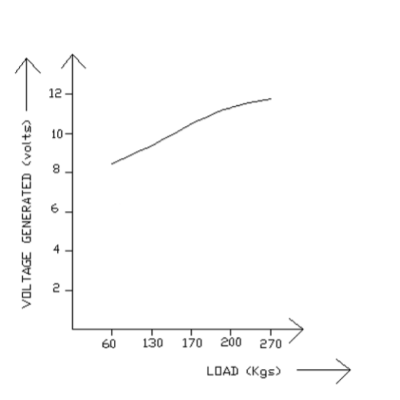
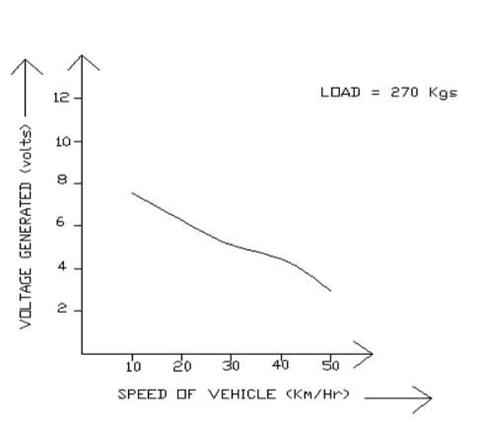
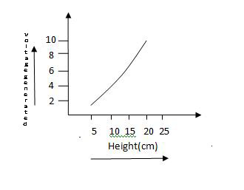
Graphical explaination of the parameters

Slide 8
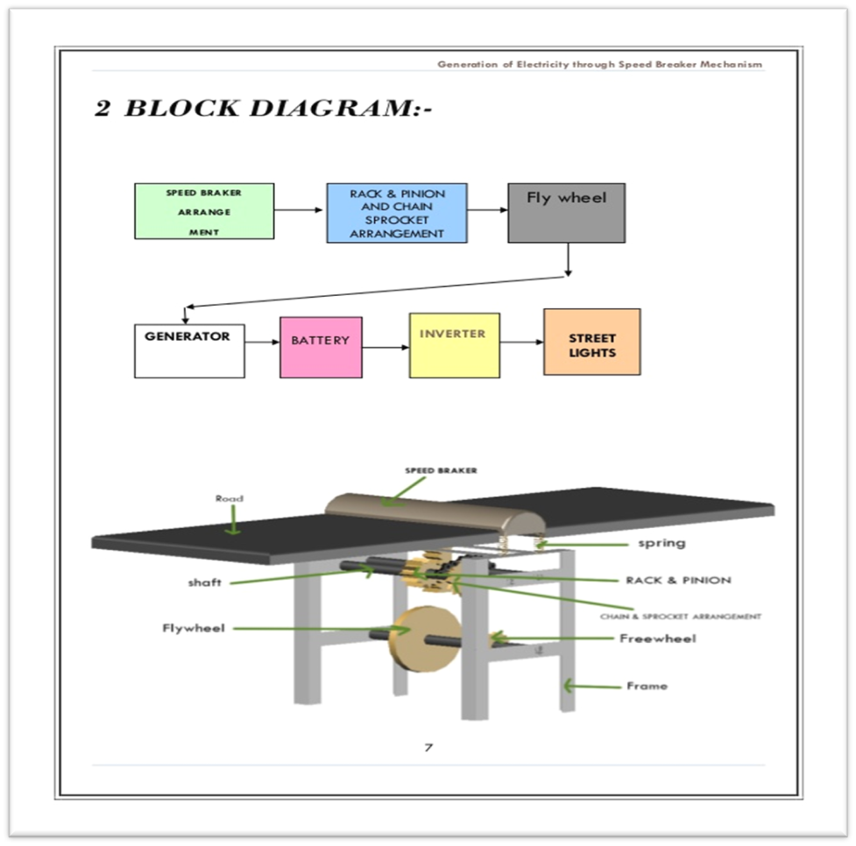
Proposed System Model

Slide 9
Equipment Required
Frame
Hump
Spring
Rack & Pinion gears
Shaft.
Sprocket
Recoil spring
Generator
Alternator
Battery
Inverter

Slide 10
keywork
Design of spring:
Its application:
We selected helical type of spring.
We select the material as Stainless steel.
We calculate the mean diameter and diameter of spring wire.
We calculate the no. of active coil(15)
Total no of coil.(for square and ground end=17)
Solid length(200mm)
Maximum deflection (44mm)
Free length.(251mm)
Pitch (15.7mm)
Frequency of spring(843.07HZ)
Frequency of application of load (44.4 HZ)
To apply forces and controlling motion.
Measuring forces, as in the case of a spring balance.
Restoring energy used in reciprocating rack.
Reducing the effect of shocks and vibrations in the system.

Slide 11
METHODOLOGY
The working principle of this power generation program is to convert the kinetic energy to electric energy via mechanical energy. This can be done when the brakes are applied upon the vehicle kinetic energy is produced. After this the kinetic energy is converted to mechanical energy using a rack and pinion gear and the by connecting the pinion gear to a generator shaft the energy is converted into electrical energy.
Speed Breaker:- This is a normally used thing in everyday life. This element can be made from the composite of carbon fiber and rubber so that the speed breaker can sustain the heavy load of vehicles such as a container filled with some
material in it. The speed breakers can be made such that the starting and ending slopes would be made up of concrete and cement mixture and the central part would be made up of the composite mentioned before.
Rack and Pinion Gear:- This is one of the simplest types of gears and can be manufactured according to ones own need. As the name suggests this type of gear has two components namely Rack which is a straight gear with tooth in only one direction, the second component is the Pinion which is a round shaped gear and will roll upon the rack to perform its task. The alignment of this gear will be in vertical direction.
Generator: – A generator is a device which converts mechanical energy into electrical energy. In this case the work of the generator remains the same and for that the shaft of the generator will have a pinion gear on its edge. The pinion gear will be meshed with the pinion gear of Rack and Pinion arrangement. As the first pinion gear will rotate the second gear will also rotate with the shaft of the generator. This will induce EMF (Electro Motive Force) in the generator and electricity will be produced.
Electricity Storage: – It is very difficult to store electricity for a long time into any kind of storage. To deal with this issue a battery pack will be introduced which will help us store the electric energy in to the battery pack. Also battery packs can be useful to transfer electric energy from one place to another.

Slide 12
Future SCOPE
This mechanism is very economical and easy to install.
Two protocols of this type of speed breakers are developed in India, not practically implemented till date.
Practically implemented in New Jersey , China and Indonesia.
Lots of researches and investigations are going on to practically utilize this technique.

Slide 13
Conclusion
The existing source of energy such as coal, oil, etc. may not be adequate to meet the ever increasing energy demands. These conventional sources of energy are also depleting and may be exhausted.
These are some non-conventional methods of producing energy. This project is a one step to path of exploring the possibilities of energy from several non-conventional energy sources.

Slide 14


